Slide 1
Project 1
Group 6
Katharine Tamas, Nairui Guo, Kashif Bashir and Khai Tran
Notes:
Introduction

Slide 2
What are we analysing:
We are running an analysis on suburbs all around Melbourne for the CEO of a real estate company that operates in most suburbs of Melbourne. The CEO wants to know which suburbs in Melbourne are the most liveable for the future young generations in terms of affordability, safety and education?
Notes:
Khai: Van is the CEO of Van Housing Real Estate and your associates Chris and Tom.

Slide 3
Liveability Factors:
AFFORDABILITY: Median House Prices
SAFETY: Crime Rates
EDUCATION: Schools
ESSENTIAL SERVICES: Hospitals, Police Stations, Supermarkets
Based on these factors, we have calculated the most liveable postcodes in Melbourne.
Notes:
Khai
Based on the question we have, we believe that these points are most essential for the benefit of the future generations
The main measure is affordability, looking at the Median House Prices across Postcodes in Melbourne.
Secondly, we will be considering the safety of each postcode based on the crime rates per population. Looking into different types of crimes and the result was a surprising.
Thirdly, we will focus on Education, as this is of high importance to prospective families planning where they will want to live in the future.
Lastly, look at the availability of essential services.

Slide 4
Data Sources
Data Set | Source | Website | Date Range | Frequency | Period
Median House Price By Year – Houses By Suburb | Victorian State Government – Department of Transport and Planning | https://www.land.vic.gov.au/valuations/resources-and-reports/property-sales-statistics | 2012 to 2022 | Annual | 1st Jan to 31st Dec
Population by Suburb | Australian Bureau of Statistics | https://api.data.abs.gov.au/files/ABS_ERP_ASGS2021_1.0.0.csv | 2001 to 2021 | Annual | 1st Jul to 30th Jun
School Locations | DataVic | https://discover.data.vic.gov.au/dataset/school-locations-2022 | As at 5th Aug 2022 | Snapshot | As at 5th Aug 2022
Crime Rates | Crimes Statistics Agency | https://www.crimestatistics.vic.gov.au/crime-statistics/latest-victorian-crime-data/download-data | 2014 to 2023 | Annual | 1st Apr to 31st Mar
Supermarkets, Police Stations and Hospitals | GeoApify | https://www.geoapify.com/ | July 2023 | Snapshot | July 2023
Notes:
Khai

Slide 5
Data Collection & Cleaning
Analysis to postcode level, as most accurate way of linking numerous data sources
Eliminated any postcodes that were not across all datasets
Grouped postcodes to “Inner”, “Mid”, “Outer” groups based on distance from the Melbourne CBD.
Where postcodes are shared by two municipalities, the postcode is reported in just one.
Data sources are the most current and available to the public.
Notes:
Khai

Slide 6
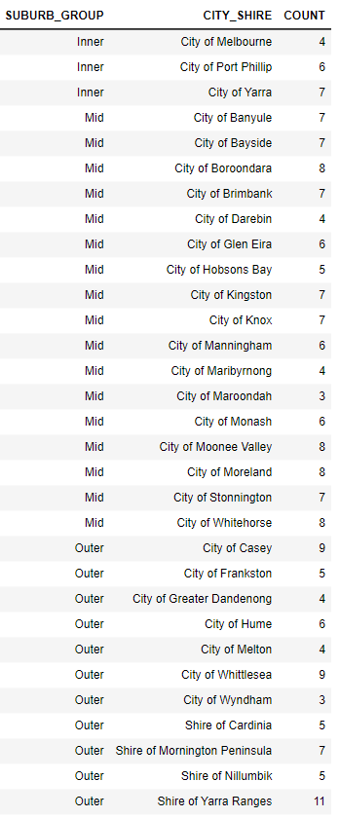
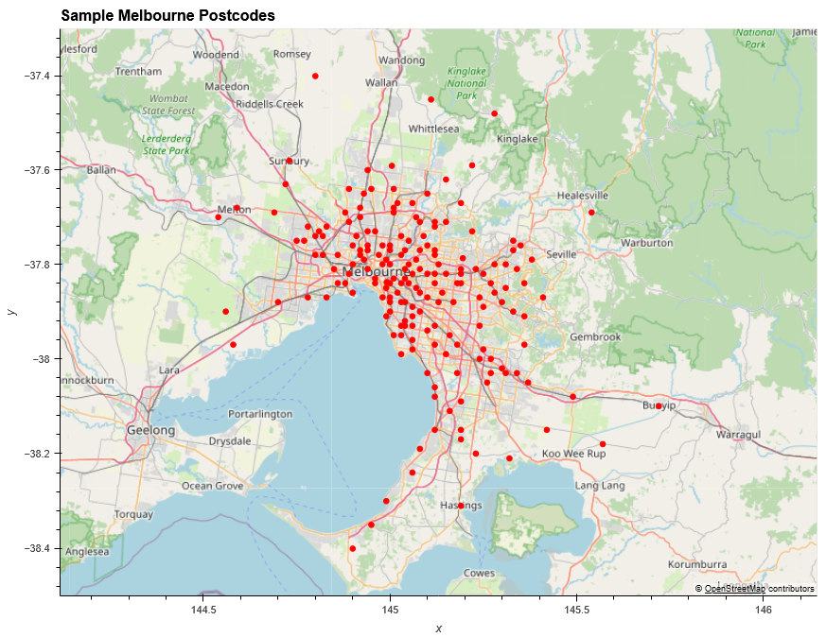
Melbourne Postcodes Sample size = 192
Sample chosen based on available data points from the various data sources.
Restricted to City-Shires within Melbourne
Notes:
Khai
All 192 postcodes, will be analysed in all sections of this analysis, for consistency
Fair representation of each City/Shire as shown by the table on the far right

Slide 7
Factor 1:
Affordability
Notes:
Kath

Slide 8
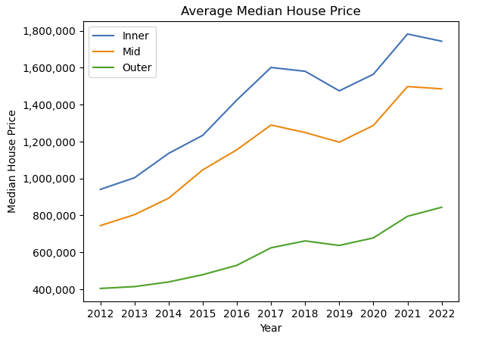
Median House Price Trend
Upward trend in median house price from 2012 to 2022
Impact of covid apparent on all areas of Melbourne
Decline in Median House Price For Inner and Mid areas, whereas Outer increasing from 2021 to 2022
Interest
Rates
Hikes
Covid
Notes:
Kath
Interest rates decreasing during Covid (2019 to 2021), increasing demand for housing, due to lower mortgage payments for prospective buyers.
Interest rate increases started mid 2022, placing added financial on mortgage repayments for households, sharp drop in demand for houses.

Slide 9
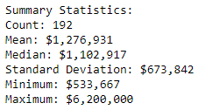
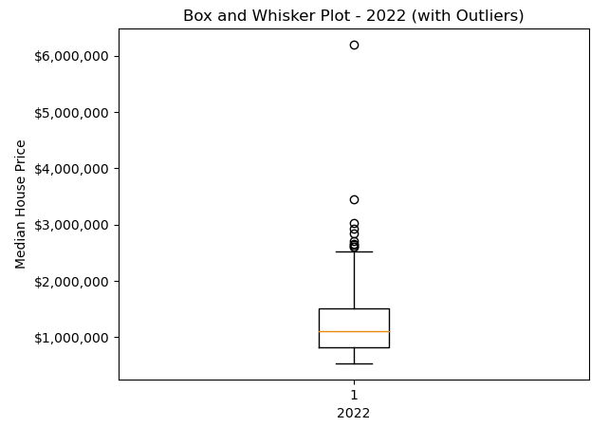

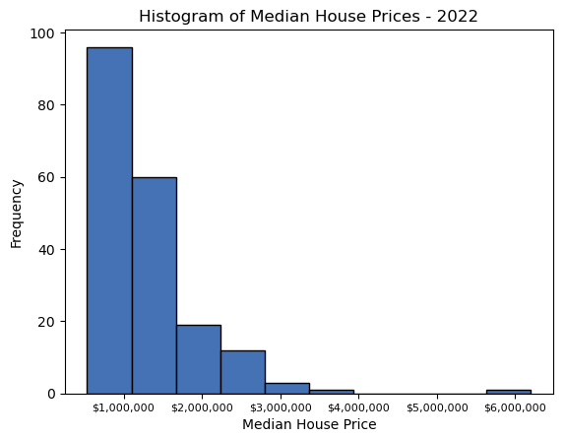

Summary Statistics
Outliers
Median
Mean
Positively skewed:
Median < Mean
Notes:
Kath
Summary stats Median House Price
Box and whisker plot
Outliers – Toorak
Breakdown of inner/mid/outer
ADD MAP of different suburbs

Slide 10
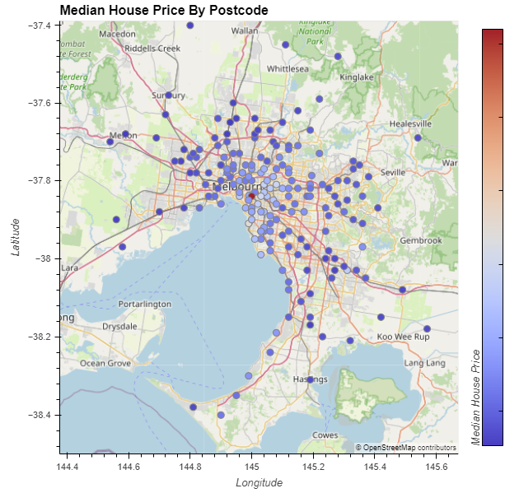
Most affordable postcodes
Most Expensive
Least expensive postcodes in mid to outer suburb groups in Melbourne (darker blue)
Most expensive tend to be in the mid-eastern area
Major outlier postcode 3142 Toorak in red.
Least Expensive
Notes:
Kath

Slide 11
Factor 2:
Safety
Notes:
David

Slide 12
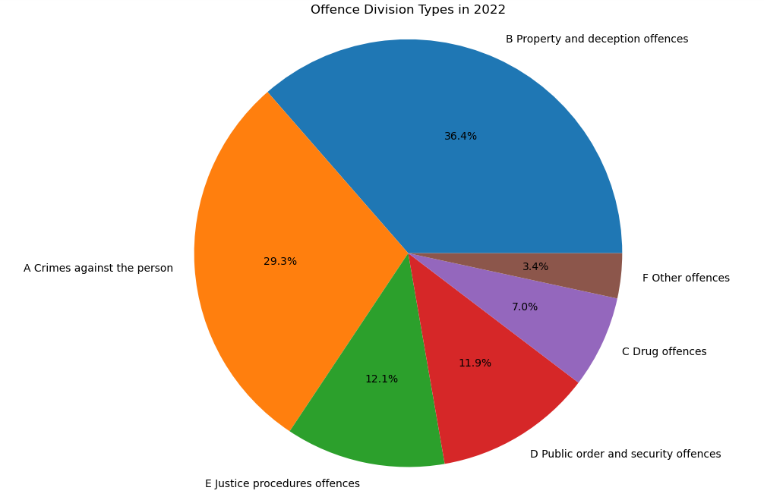
Crime Types
Crimes against the person
Homicide, Assault, Sexual offences, Abduction, Robbery, Blackmail and extortion, Stalking, harassment & Dangerous and negligent acts endangering people
Property and deception offences
Arson, Property damage, Burglary/Break and enter, Theft, Deception
Drug Offences
Drug dealing, Cultivate or manufacture drugs, Drug use and possession
Public order and security offences
Weapons and explosives, Disorderly and offensive conduct, Public nuisance, Public security offense
Justice procedures offences
Justice procedures, Breaches of orders
Other Offences
Transport regulation offences, Other government regulatory offences
Notes:
Data range: 1/4/2022 to 31/3/2023
Crimes against the person : these includes offences such as: Homicide, Assault, Sexual offences, Abduction, Robbery, Blackmail and extortion, Stalking, harassment & Dangerous and negligent acts endangering people.
Property and deception offences: Arson, Property damage, Burglary/Break and enter, Theft, Deception
Drug Offences: Drug dealing, Cultivate or manufacture drugs, Drug use and possession
Public order and security offences: Weapons and explosives, Disorderly and offensive conduct, Public nuisance, Public security offenes
Justice procedures offences: Justice procedures, Breaches of orders
Other Offences: Transport regulation offences, Other government regulatory offences.

Slide 13
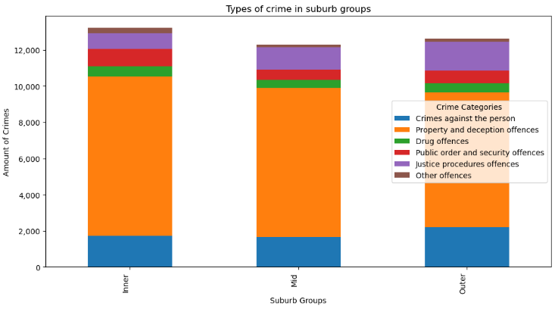
Crime Types
Inner Suburbs:
Mid Suburbs:
Outer Suburbs:
15 postcodes
7 police stations.
44 police stations
33 police stations
0.47
0.40
0.46
111 Postcodes
Inner Suburbs: 15 postcodes
7 police stations. 0.47
Mid Suburbs: 111 Postcodes
44 police stations 0.40
Outer Suburbs: 71 Postcodes
33 police stations 0.46
71 Postcodes
Notes:
Data range: 1/4/2022 to 31/3/2023

Slide 14
Factor 3:
Education
Notes:
Kashif

Slide 15

School Types
Count of schools
Summary stats on schools
Education Sectors
Notes:
NEED TO ADD OUTLIERS TO CHART
Make table prettier
Analysis:
on average there is around 4 primary schools per suburb, 1 highschool
Language, Pri/Sec and Special Schools are rare.

Slide 16
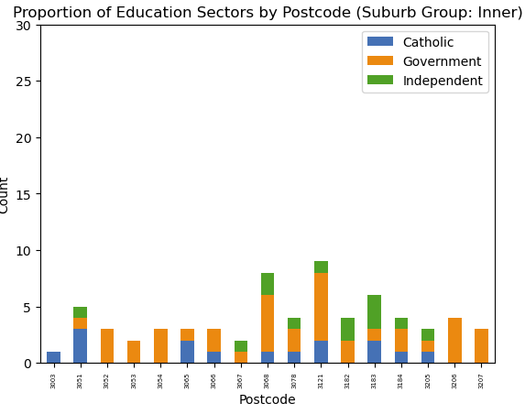
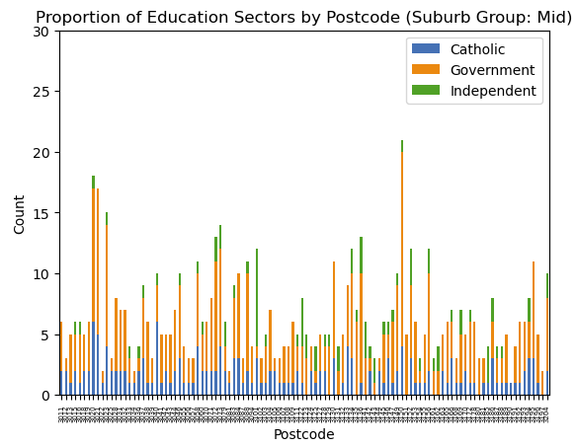
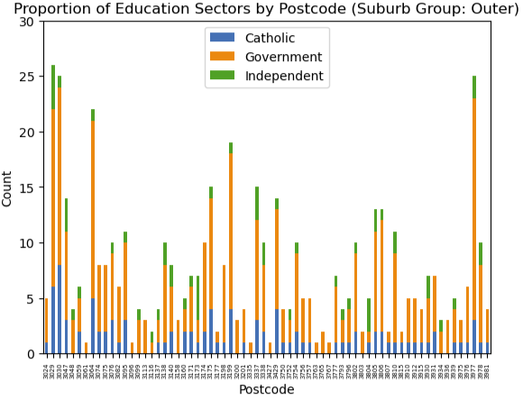
Education Sectors
Highest number of schools:
Postcodes 3029, 3030, 3977
Notes:
Kashif
Postcodes 3029, 3030, 3977
Mention names representing these postcodes
Maybe population numbers
Population count per school in those postcodes

Slide 17
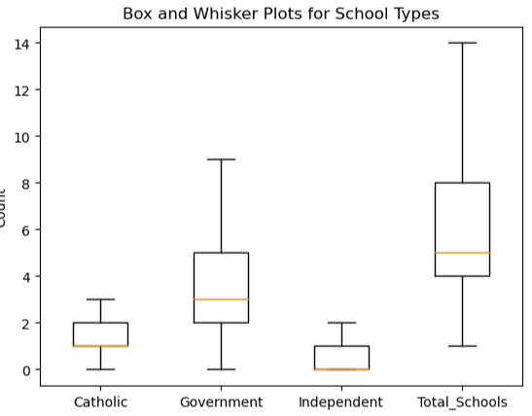
Education Sectors
Count of schools
Summary stats on schools
Types of schools
Education Sectors
Notes:
Kashif

Slide 18
Findings
???
Notes:
Kashif

Slide 19
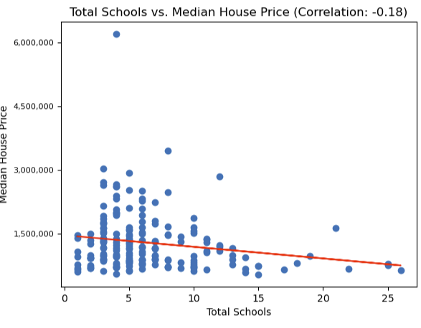
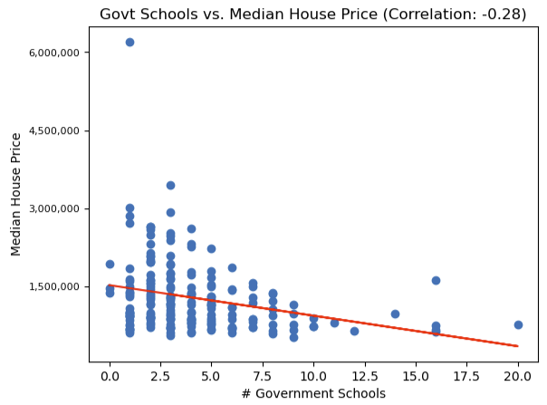
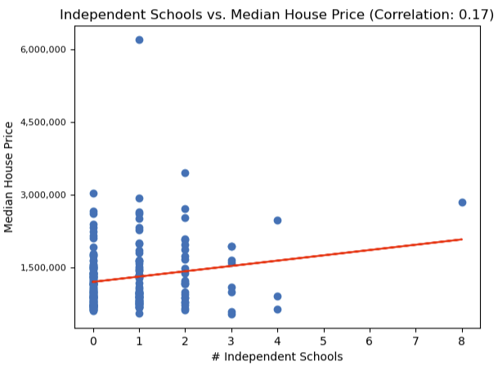
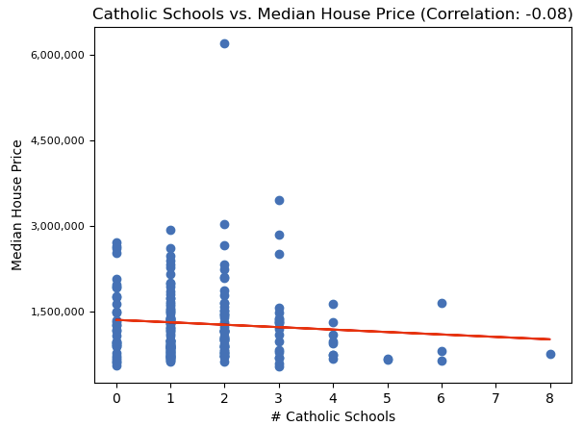
Correlation Median House Price vs School Types
Little correlation between Median House Prices and Schools and the count of school types in each suburb
Notes:
Kashif
We ideally wanted to have score ATAR data and state rankings, but was unavailable in the format required for this analysis

Slide 20
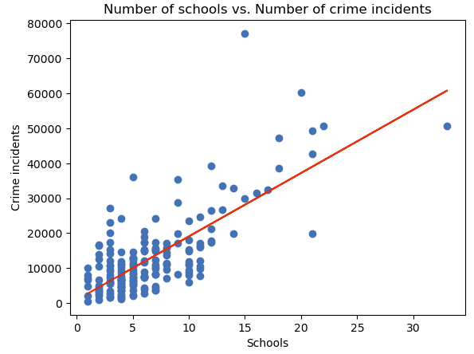
Correlation: Schools vs Crime Incidents
Correlation of schools to number of crime incidents have a positive relationship
Correlation coefficient = ????
Need to update data source
Notes:
Kashif

Slide 21
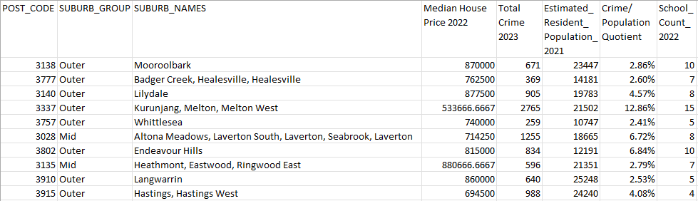
Top 10 Postcodes – liveability score
Notes:
David

Slide 22
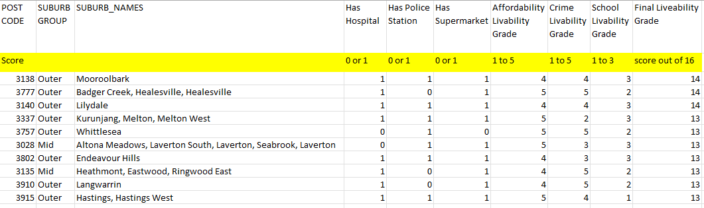
Top 10 Postcodes – liveability score
Key:
Hospital, Police Station, Supermarket
0 = none, 1 = has at least one
Affordability, Crime, School
1=worst outcome to 5 = best outcome
Notes:
David
Explain key – bigger weight applied to house price, crime, followed by school availability
8 are from outer postcodes outer suburbs

Slide 23
Summary
Most liveable postcodes are located in the Outer suburb group, then Mid suburb groups.
Inner suburbs all rank 119th place and lower, based on affordability Inner suburbs have the most crime and highest median price compared to other suburb groups (mid and outer)
Recommendations for further analysis:
School ranking/score data – ATAR & Naplan results
Restaurants, Green spaces availability
Notes:
Kath
Affordability is the main driver of liveability. Crime rates is second with Mid having the least number of crimes and Inner having the most.
There were schools across all postcodes, the distribution of police stations, hospitals and supermarkets were fairly even between suburb groups.
Explain key – bigger weight applied to house price, crime, followed by school availability
with a minimum median house price of $1.3 million for postcode 3066 Collingwood, and maximum postcode 3206 Albert Park, Middle Park.
Further investigation into school data required. We only gave it a liveability score from 1 to 3, as the data did not include school ranking in Melbourne.
Also would be good to look the availability of restaurants and green spaces in each postcode.

Slide 24
Thankyou!

